Slide 1

Life Expectancy Analysis Capstone 3 presentation
By – Sarita Thapar
Date 7/11/2022

Slide 2
Introduction
The goal of this analysis is to find correlation between following factors that affects life expectancy around the world.
Schooling
Income composition of resources
Adult mortality
HIV/AIDS
This will help anybody who wants to understand and take actions on personal level and/or global level to make changes to prolong life expectancy.

Slide 3
The Dataset
This dataset is available on Kaggle.com
It has data for 193 countries which was observed for 15 years from year 2000 to 2015.
It contains 2938 rows and 22 columns with categorical and quantitative variables.
For this analysis we are using only 5 columns:
Schooling
Income composition of resources
Life expectancy
Adult mortality
HIV/AIDS

Slide 4
The Research Question
There are 2 questions that we are addressing in the analysis.
Is there a correlation between schooling, income composition of resources and life expectancy?
Is there a correlation between HIV/AIDS, adult mortality and life expectancy?

Slide 5
Hypothesis
There are two hypothesis related to the research questions:
Hypothesis #1
Ho: There is no linear correlation between schooling, income composition of resources and life expectancy.
Ha: There is a linear correlation between schooling, income composition of resources and life expectancy.
Hypothesis #2
Ho: There is no linear correlation between HIV/AIDS, adult mortality and life expectancy.
Ha: There is a linear correlation between HIV/AIDS, adult mortality and life expectancy.

Slide 6
How will the data test the hypothesis?
The data will be used to test the hypothesis in the following ways:
Pearson r test will be conducted to find the p-value and the strength of the correlation.
Visualizations will show the correlation between the factors.

Slide 7
How will the findings be used?
The findings will be very helpful for anyone who is interested in finding what causes life expectancy to increase or decrease.
This analysis can be used by health departments and school districts to understand the impact of their work.

Slide 8
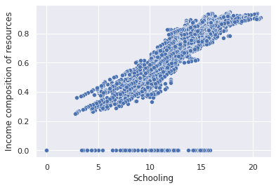
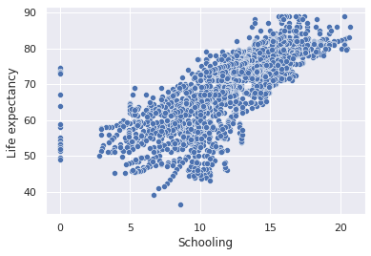
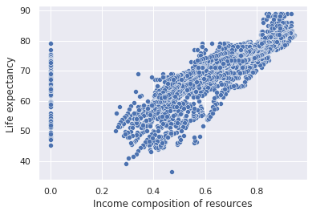
The Analysis – Hypothesis #1
This scatter plot visualization shows that all 3 factors have a strong positive correlation.
P-value 0.0 < alpha 0.05, thus we reject the Ho that there is no linear correlation between schooling and income composition of resources.
The Pearson correlation coefficient of 0.80 indicates there is a strong positive linear correlation between schooling and income composition of resources.
P-value 0.0 < alpha 0.05, thus we reject the Ho that there is no linear correlation between schooling and life expectancy.
The Pearson correlation coefficient of 0.75 indicates there is a strong positive linear correlation between schooling and life expectancy.
P-value 0.0 < alpha 0.05, thus we reject the Ho that there is no linear correlation between income composition and life expectancy.
The Pearson correlation coefficient of 0.72 indicates there is a strong positive linear correlation between income composition of resources and life expectancy.

Slide 9
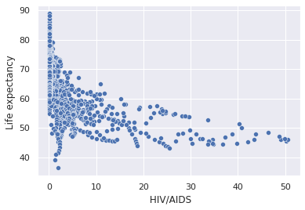
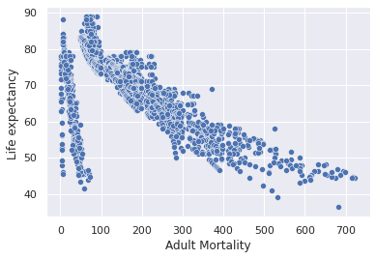
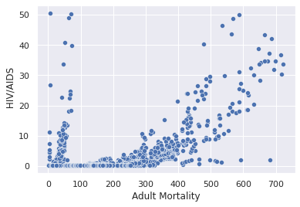
The Analysis – Hypothesis #2
This scatter plot visualization shows that adult mortality and HIV/AIDS have negative correlation with life expectancy, but adult mortality has a stronger correlation with HIV/AIDS.
P-value 0.0 < alpha 0.05, thus we reject the Ho that there is no linear correlation between HIV/AIDS and life expectancy.
The Pearson correlation coefficient of -0.56 indicates there is a moderate negative linear correlation between HIV/AIDS and life expectancy.
P-value 0.0 < alpha 0.05, thus we reject the Ho that there is no linear correlation between adult mortality and life expectancy.
The Pearson correlation coefficient of -0.68 indicates there is a moderate negative linear correlation between adult mortality and life expectancy.
P-value 0.0 < alpha 0.05, thus we reject the Ho that there is no linear correlation between adult mortality and life expectancy.
The Pearson correlation coefficient of 0.52 indicates there is a moderate positive linear correlation between adult mortality and HIV/AIDS.

Slide 10
Project Summary
Hypothesis #1 has been rejected. There is a strong linear correlation between schooling, income composition of resources and life expectancy. This suggests that life expectancy and income composition of resources will increase with education.
Hypothesis # 2 has been rejected. Both HIV/AIDS and adult mortality have a moderate negative linear correlation with life expectancy. But HIV/AIDS and adult mortality have a moderate positive linear correlation. This means that if HIV/AIDS and adult mortality increases then life expectancy decreases.

Slide 11
Recommendation
There are several factors that increases life expectancy. This analysis strongly suggests that education is one of them. Therefore, focusing on education is very important for a country to increase its life expectancy and income composition.
This analysis also suggests that as cases of HIV/AIDS and adult mortality increases, life expectancy decreases. Therefore, I strongly suggest further analysis on the causes of adult mortality and care related to HIV/AIDS.

Slide 12
THANK YOU!

